Slide 1
Containers from scratch
—
Pavel Malinov
SME

Slide 2
Contents
Part One 1
What is a container 2
Part Two 3
Namespaces
Part Three 4
Chroot
Part Four 5
Control Groups

Slide 3
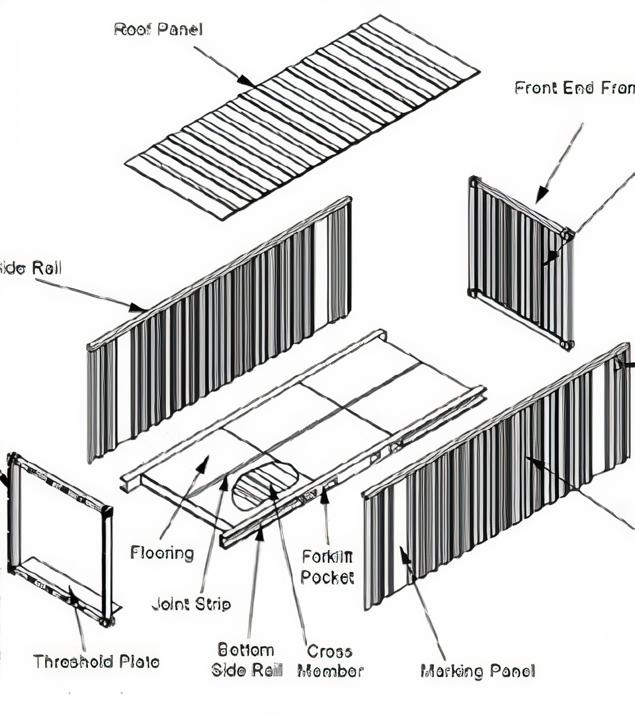
Build my own container in GO
Namespaces
Chroot
Cgroups

Slide 4
Namespaces
What you can see
Syscalls are used for creation
  UTS - unix timesharing system
  PIDs
  Mounts
  Network
  User IDs
  InterProcess comms

Slide 5
Chroot
Set root directory to a subdirectory within host’s root
Host sees:
/foo/directory/on/host/bar
/foo/directory/on/host/some_dir/that_file
Container with chroot to
/foo/directory/on/host

Slide 6
CGroups
What you can use
Filesystem interface
  memory
  CPU
  I/O
  Process numbers
  Many more

Slide 7
: () { : | : & }; :

